Slide 1
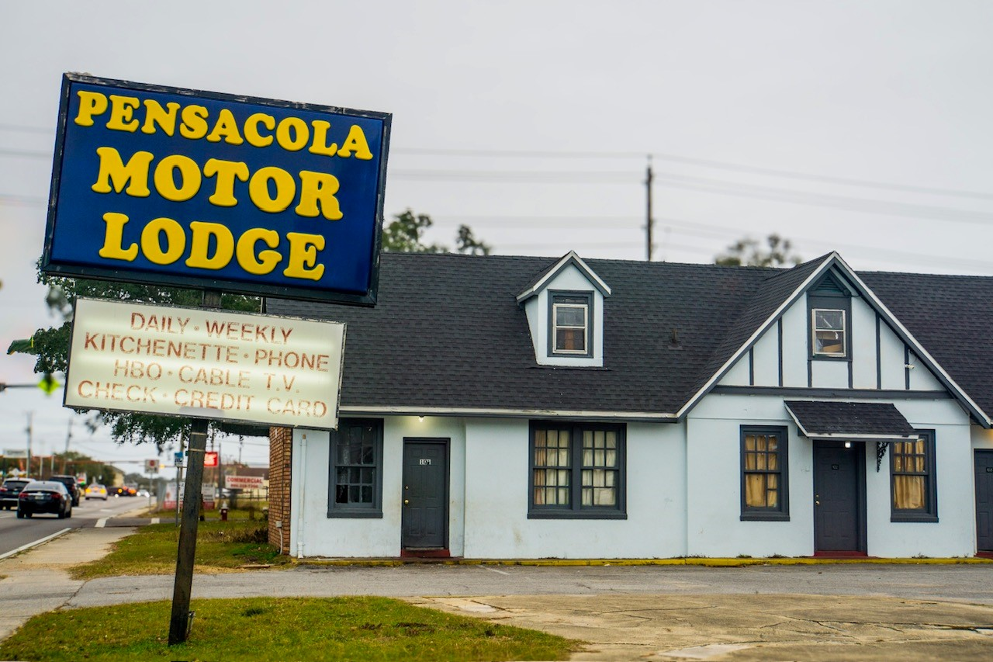
Request for letters of interest
2305 W Cervantes Street, Pensacola FL
Informational
Conference
Mar 11, 2024 – 9 a.m.
Site Visit to Follow 10:15 to 11:15 a.m.

Slide 2
GAUGE MARKET INTEREST
ENCOURAGE COLLABORATION & PARTNERSHIP
Purpose of the Solicitation
REFINE PROJECT SCOPE / SELECT A DEVELOPMENT PARTNER

Slide 3
2305 W CERVANTES ST
Contains 11 buildings (11,774 sf), 30 motel rooms and an office/manager apt.
Originally constructed in 1932 using stucco over concrete block.
Historically operated as a motor lodge.
Located along an urban renewal corridor
Approx. 1 mile to Downtown Pensacola
Acreage: 1.57 acres
Anticipated Conveyance Type: Long Term Ground Lease (Waived lease fee through Apr 1, 2037)
PROPERTY DESCRIPTION

Slide 4
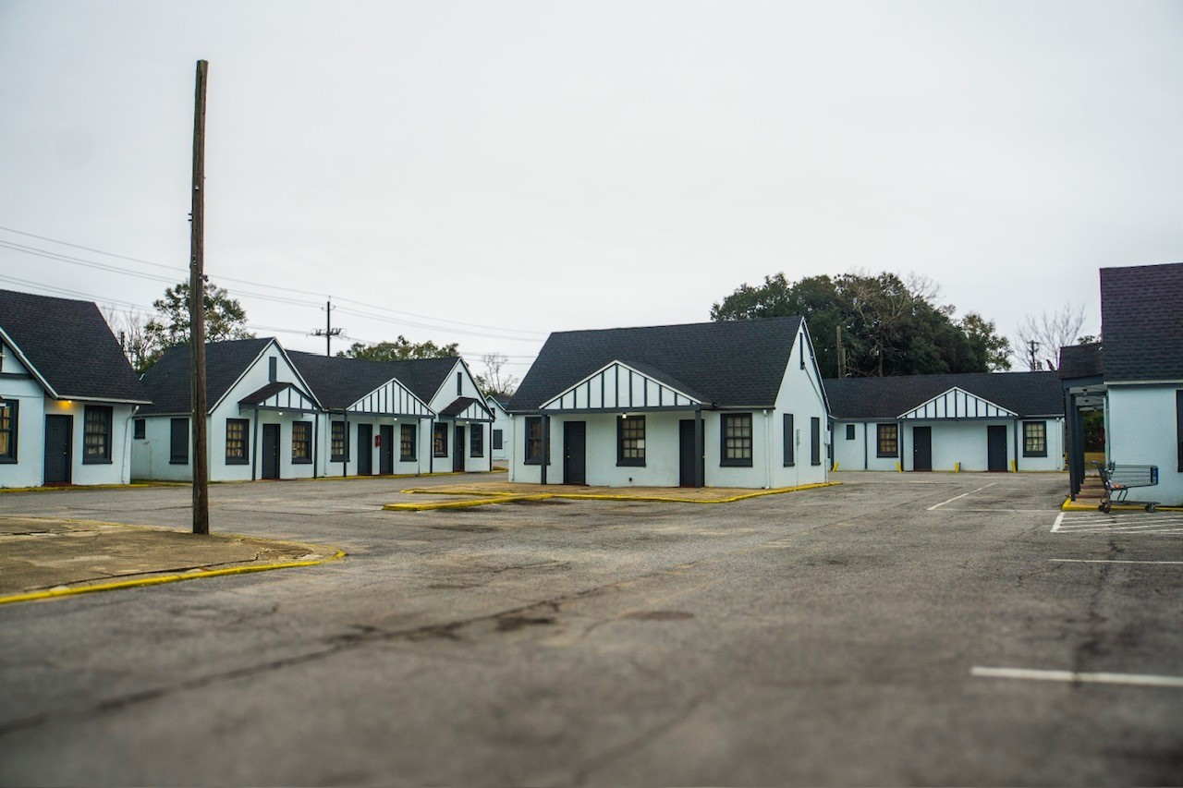
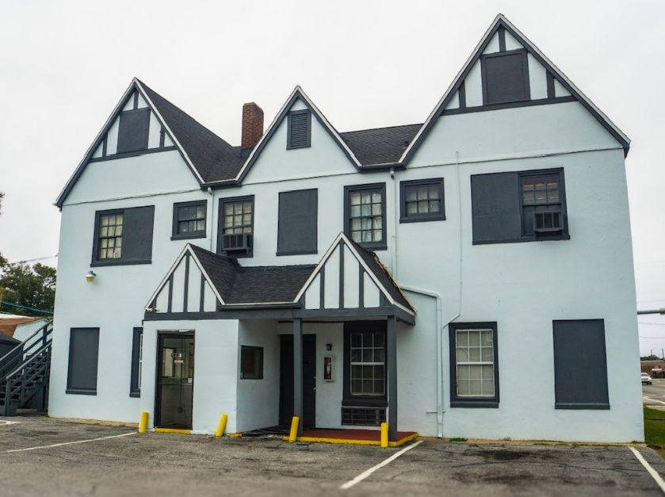
TODAY

Slide 5
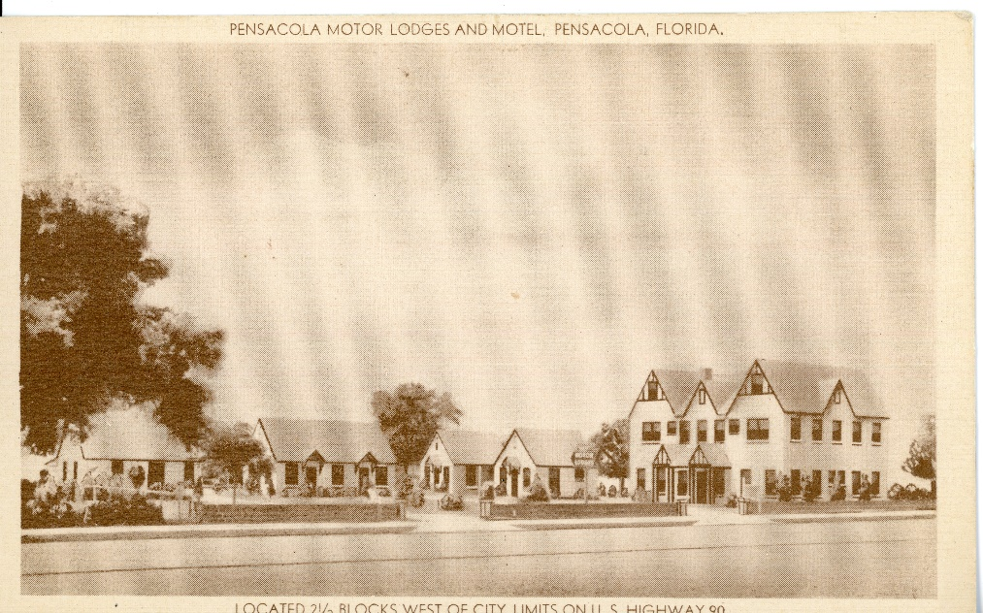
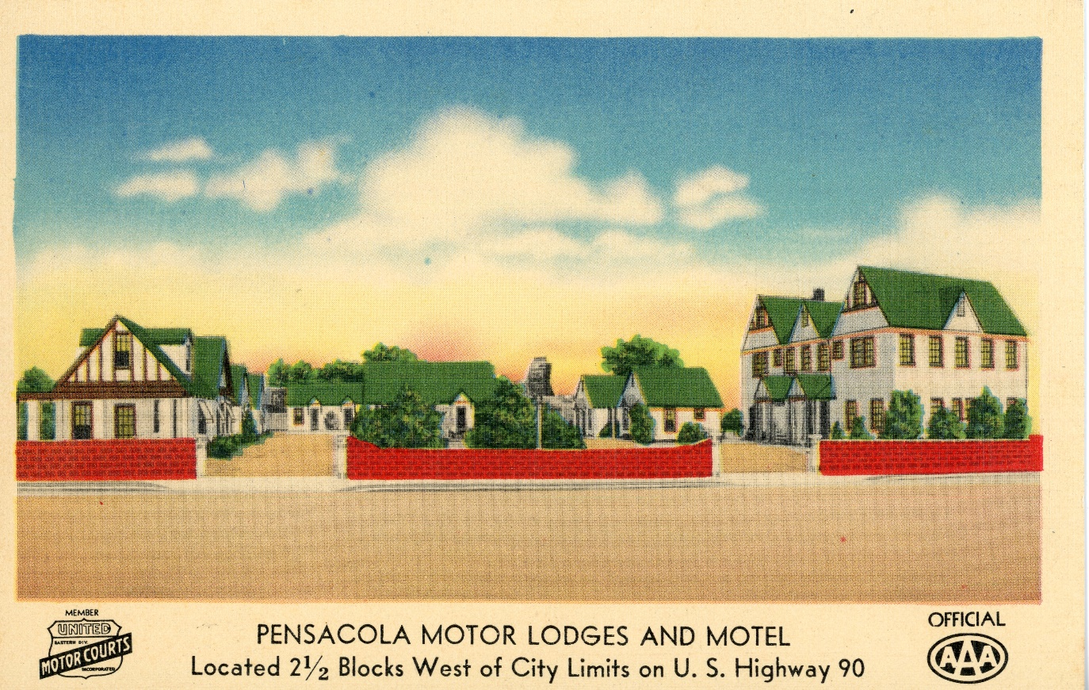
HISTORIC IMAGES

Slide 6
2305 W CERVANTES ST
Zoning District: C-3, Commercial Zoning District
Special District: Urban Design Overlay District (New construction only)
Max. Height: 10 stories (150’ w/ bonus)
Max. Density: 35 units/acre *Bonuses available.
Zoning & development

Slide 7
Seeking impactful proposals that produce attainable housing with an emphasis on low income and special needs housing.
Project may be rehabilitation, new construction or both.
Create Rental Housing. Seeking multi-family rental housing. May include supplemental commercial.
Affordability. 60-100% AMI. Min. 30-year affordability period.
Mixed income. 50% of units at or below 60% AMI, mix up to 100% AMI.
Celebrates Historic Vernacular. Only example of Tudor style in the area.
Quality Design. Project should visually and functionally enhance urban renewal corridor.
Project Goals

Slide 8
Identify Lead & Team
Degree of Interest
Project Description
Preliminary Development Budget & Financing Plan
Experience
Any Additional Feedback
Submittal components

Slide 9
ANTICIPATED TIMELINE
MARCH 11, 2024
INFORMATIONAL CONFERENCE & SITE VISIT
MARCH 15, 2024
FREQUENTLY ASKED QUESTIONS
MARCH 24, 2024
CLOSE DATE (Subject to Extension)
5:00 p.m. local time
Visit Our Website
*EXTENSIONS WILL BE POSTED TO THE WEBSITE & NOTIFICATION SENT VIA THE “NOTIFY ME” LISTS
RESPONDENTS WILL BE NOTIFIED DIRECTLY OF NEXT STEPS

Slide 10
STAY IN TOUCH
CHECK THE WEBSITE
REGISTER FOR NOTICES
EMAIL QUESTIONS
https://www.cityofpensacola.com/List.aspx
Register for “CRA Project Updates” and “Bid Posting” lists
REDEVELOPMENT@CITYOFPENSACOLA.COM

Slide 11
another
development opportunity
101 w Main Street– DOWNTOWN PENSACOLA
Acreage: .63 acres
Max Height: 80’ above flood elevation (Bonus Available)
Density: 108 du/acre (Bonus or Transfers Available)
FEB 29, 2024
INFORMATIONAL CONFERENCE & SITE VISIT
We’re seeking:
PAST - RECORDING AVAILABLE
High density residential/mixed use that maximizes economic impact and public enjoyment of the waterfront.
MARCH 8, 2024
FREQUENTLY ASKED QUESTIONS
MARCH 17, 2024
CLOSE DATE (Subject to Extension)
5:00 p.m. local time
*EXTENSIONS WILL BE POSTED TO THE WEBSITE & NOTIFICATION SENT VIA THE “NOTIFY ME” LISTS
RESPONDENTS WILL BE NOTIFIED DIRECTLY OF NEXT STEPS

