Slide 1
CITY OF PENSACOLA CRA 101 W. MAIN STREET
(OPPORTUNITY SNAPSHOT)
F E B R U A RY 2 0 2 4

Slide 2
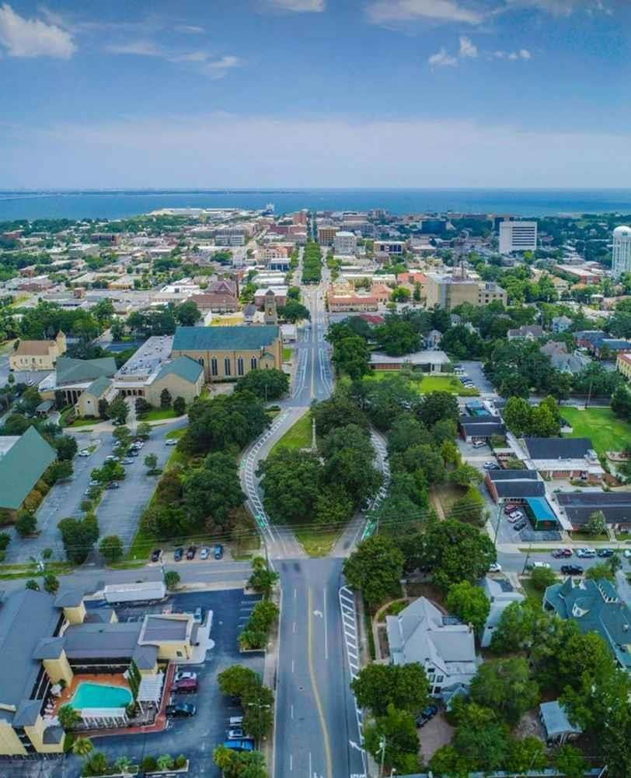
THE OPPORTUNITY
“The pandemic housing boom was generous to the
Pensacola region…Downtown development and throughout the City has remained on an upward trajectory…” – Wall Street Journal (February 23, 2024)
Outlook for regional population and employment growth is robust
101 W. Main St. (subject site) as standalone envisions multifamily
residential
However, redevelopment opportunity expands significantly with prospective acquisition of Harbourview Office building and parking garage
Collective opportunity to create a unique, large-scale mixed-use
development in-line with the vision of the waterfront master plan
Multifamily residential
Office
Hotel
Ground floor retail

Slide 3
DEMOGRAPHIC SNAPSHOT: 2022
City and County
 | Pensacola | Escambia County
Total Population ACS 2022 | 54,059 | 321,296
2010 Census Population | 51,923 | 297,619
Households ACS 2022 | 24,771 | 126,537
Avg. HH Size ACS 2022 | 2.16 | 2.39
Median Household Income ACS 2022 | $67,722 | $61,642
Per Capita Income ACS 2022 | $43,695 | $33,702
% Above $50K ACS 2022 | 61.7% | 59.9%
Owner Occupied Households % ACS 2022 | 62.1% | 63.1%
Renter Occupied Households % ACS 2022 | 37.9% | 36.9%
Source: Census 2000 , 2010 , 2020 , ACS 2010 & 2022

Slide 4
POPULATION GROWTH TRENDS
ESCAMBIA COUNTY, CITY OF PENSACOLA
1.00%
0.80%
0.60%
0.40%
0.20%
0.00%
-0.20%
-0.40%
-0.60%
-0.80%
-1.00%
0.79%
0.50%
0.11%
2000-2010
2010-2020
2020-2045
County
City
Source: US Census; Florida-Alabama TPO LRP 2045

Slide 5
ESCAMBIA COUNTY
EMPLOYMENT VS. POPULATION PROJECTIONS 2020 TO 2045
0.90%
0.80%
0.70%
0.60%
0.50%
0.40%
0.30%
0.20%
0.10%
0.00%
0.80%
0.50%
2020-2045
Population Employment
Source: US Census; Florida-Alabama TPO LRP 2045

Slide 6
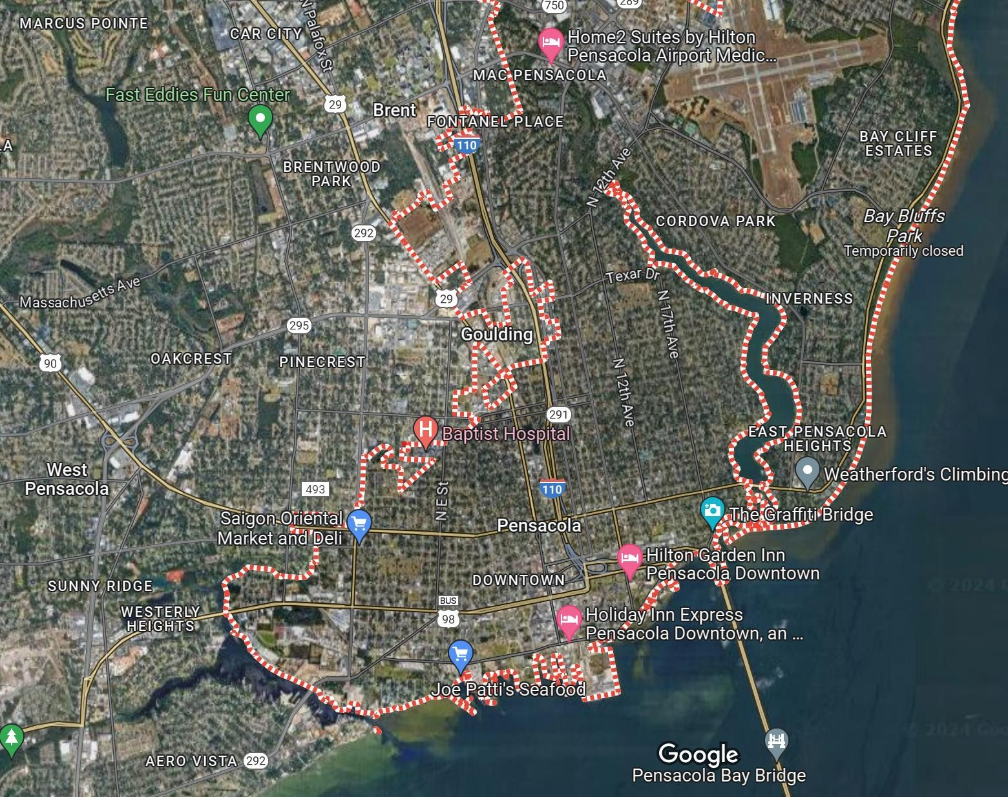
 | Property Address | Property Name | Yr. Built | # Units
 | Market Rate
1 | 51 S Coyle St | Palmilla Apartments | 2023 | 240
2 | 101 E Romana St | Southtowne | 2018 | 258
 | Rent Restricted
3 | 1717 W Cervantes St | Vista 17 at Cervantes | 2020 | 72
4 | 2910 W De Soto St | Brownsville Manor | 2020 | 88
5 | 3390 West Park Pl | Fairfield Manor Senior | 2016 | 92
NEWER MULTIFAMILY RENTAL –
DOWNTOWN PENSACOLA
 | City | Downtown
Total No. Units | 22,700 | 2,600
Market Rate Units Built w/in 10 yrs | 4,483 | 526
Avg. Asking Rent - 10 Yrs. | $1,860 ($1.61/SF) | $2,050 ($2.20/sf)
Occupancy - overall | 90% | 94%
5
Includes Palmilla currently in lease-up
83% occupancy
Est. absorption 12-15 units per month
Source: Costar
4
3
1
2

Slide 7
SELECT NEW OFFICE –
DOWNTOWN PENSACOLA (>30,000 SF)
 | Address | Name | Yr Built | RBA
1 | 420 E Romana St | Levin Center for IHMC | 2016 | 30,000
2 | 219 E Garden St | Garden Gateway Building | 2018 | 48,915
3 | 125 E Intendencia St |  | 2018 | 60,000
4 | 350 W Cedar St | Maritime Place | 2014 | 66,000
 | City | Downtown
Total Sq.Ft. | 14.8 million | 6.5 million
Built w/in 10 Yrs. | 2.0 million (Avg. 200K/yr.) | 320,000 (Avg. 32K/yr.)
Avg. Asking Lease Rate FS - 10 Yrs. | $30/SF | $30/SF
Occupancy | 98+% | 98+%
₃ 2
1
Source: Costar
4

Slide 8
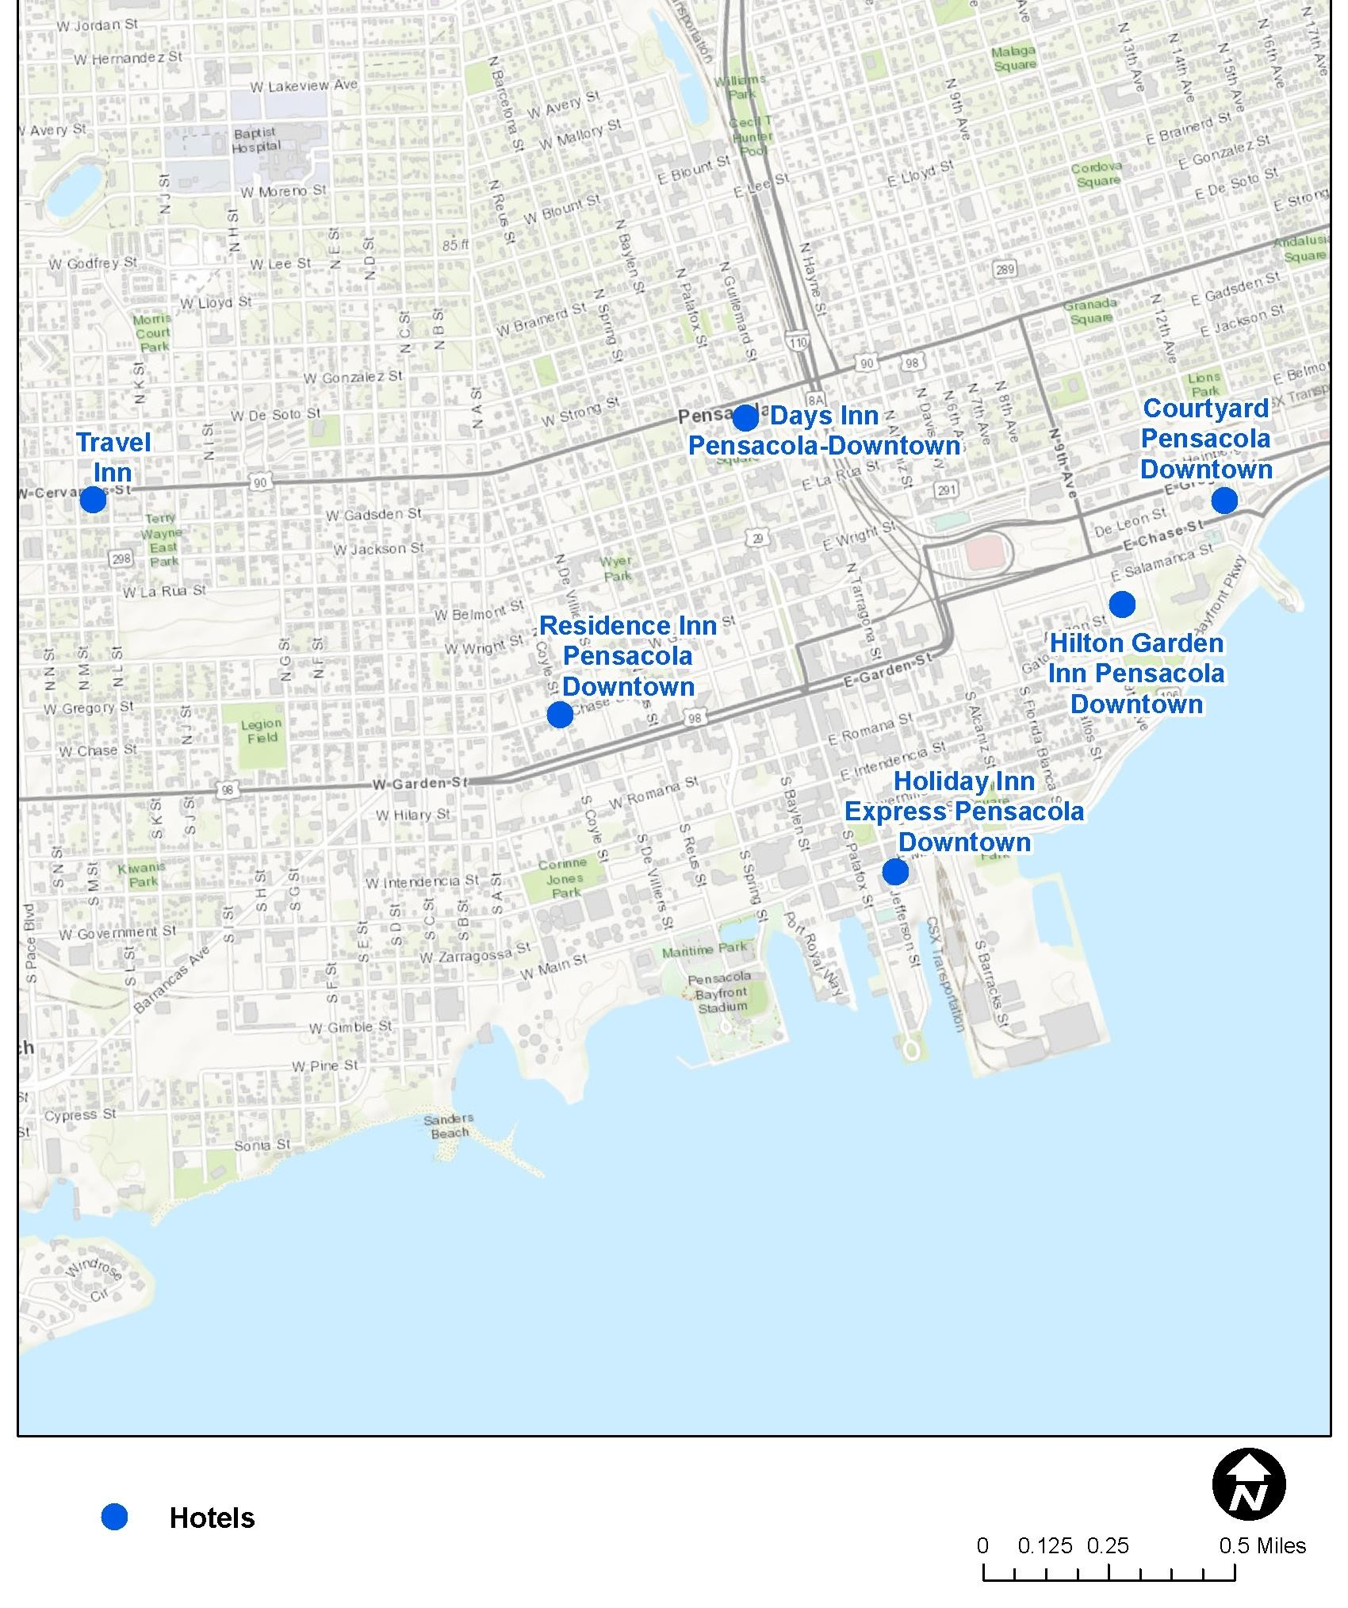
SELECT NEW HOTEL –
DOWNTOWN PENSACOLA (>50 ROOMS)
Property Name | Rooms | Year Built
Travel Inn | 64
Residence Inn Pensacola Downtown | 78 | 1998
Days Inn Pensacola-Downtown | 98 | 1962
Hilton Garden Inn Pensacola Downtown | 102 | 2023
Holiday Inn Express Pensacola DT | 106 | 2017
Courtyard Pensacola Downtown | 120 | 2007
 | City | Downtown
Rooms | 6,385 | 606
Built w/in 10 Yrs. | 1,029 | 208
Trailing 12 ADR | $161 | $145
T-12 Occupancy | 71% | 67%
Source: Costar

