Slide 1
Request for letters of interest
101 West Main Street, Pensacola FL
Informational
Conference
Feb 29, 2024 – 2 p.m.
Site Visit to Follow - 3 to 4 p.m.

Slide 2
GAUGE MARKET INTEREST
ENCOURAGE COLLABORATION & PARTNERSHIP
Purpose of the Solicitation
REFINE PROJECT SCOPE / SELECT A DEVELOPMENT PARTNER

Slide 3
101 W MAIN STREET
Contains 1-story office building (3,721 sf)
Steps to Pensacola Bay waterfront & Baylen Slip
One block to Palafox Street (east) and Community Maritime Park/Blue Wahoos Stadium (west)
Acreage: .62 acres
Anticipated Conveyance Type: Long Term Ground Lease
PROPERTY DESCRIPTION

Slide 4
101 W MAIN STREET
Zoning District: South Palafox Business District
Max. Height: 80 ft above flood elevation (150’ w/ bonus)
Preferred Height: Approx. 90 ft – Main Street; 60-80’ Cedar Street
Max. Density: 108 units/acre (67 units) *Bonuses available.
Required Setbacks: None. (Except to comply with fire safety codes)
Zoning & development

Slide 5
HARBOURVIEW SITES – 25 W CEDAR STREET
Listed for sale by a private owner (on City ground-leased land). See RLOI for real estate listing.
2 Parcels
3-story parking garage
6-story Waterfront Office Building (84,565 sf)
Adjacent for-sale parcels
Acreage: .72 acres
Acreage: .46 acres
Total Acres – All Sites: 1.8 acres

Slide 6
HARBOURVIEW SITES – 25 W CEDAR STREET
Zoning District: Waterfront Redevelopment District
Zoning same as 101 West Main Street
Preferred Height: 90’ – Main Street; 80’ Cedar Street
Max. Density: 77 units + bonuses
Zoning & development

Slide 7
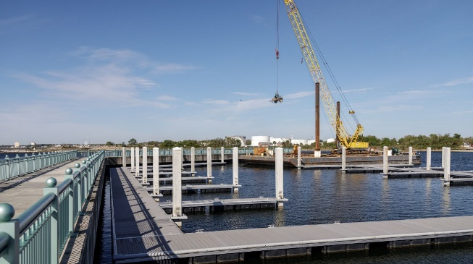
Waterfront trail & downtown amenities
101 W Main St
Bruce Beach Waterfront Park
Main St
Waterfront Trail
Parking Garage
Bartram Park
Pensacola Beach
- Pensacola Bay Bridge Multiuse Path
Community Maritime Park
- Day Use Marina
- Redevelopment Parcels
6-Story Office
Waterfront Trail
Palafox St
Baylen Slip
Promenade
Port of Pensacola
- The Fish House Restaurant
- Home of American Magic
- Pickleball Courts
Palafox Pier
Plaza de Luna Park
Ferry Landing
Visit Our Website

Slide 8
Ideal project will encompass a broad master plan with the overarching objective of maximizing economic impact and public enjoyment of the waterfront.
High density residential/mixed use. A “live, work, play” downtown district. Job growth.
Create active streets. An “everyday” reason to walk and bike, visit the waterfront and Palafox St.
Public link to the adjacent waterfront. Elevated public spaces w/ waterfront views, outdoor spaces, recreation.
Project Goals
Creative/strategic parking management.

Slide 9
Identify Lead & Team
Degree of Interest
Project Description
Preliminary Development Budget & Financing Plan
Experience
Any Additional Feedback
Submittal components

Slide 10
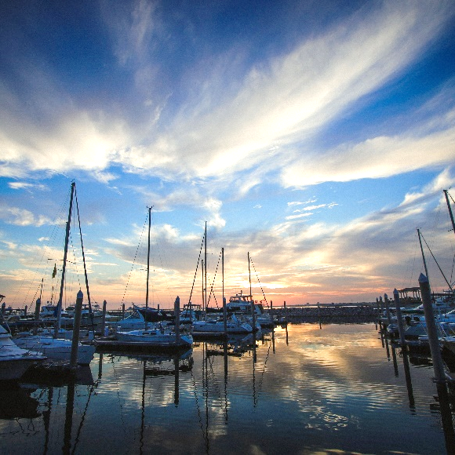
ANTICIPATED TIMELINE
FEBRUARY 29, 2024
INFORMATIONAL CONFERENCE & SITE VISIT
MARCH 8, 2024
FREQUENTLY ASKED QUESTIONS
MARCH 17, 2024
CLOSE DATE (Subject to Extension)
5:00 p.m. local time
Visit Our Website
*EXTENSIONS WILL BE POSTED TO THE WEBSITE & NOTIFICATION SENT VIA THE “NOTIFY ME” LISTS
RESPONDENTS WILL BE NOTIFIED DIRECTLY OF NEXT STEPS

Slide 11
STAY IN TOUCH
CHECK THE WEBSITE
REGISTER FOR NOTICES
EMAIL QUESTIONS
https://www.cityofpensacola.com/List.aspx
Register for “CRA Project Updates” and “Bid Posting” lists
REDEVELOPMENT@CITYOFPENSACOLA.COM

Slide 12
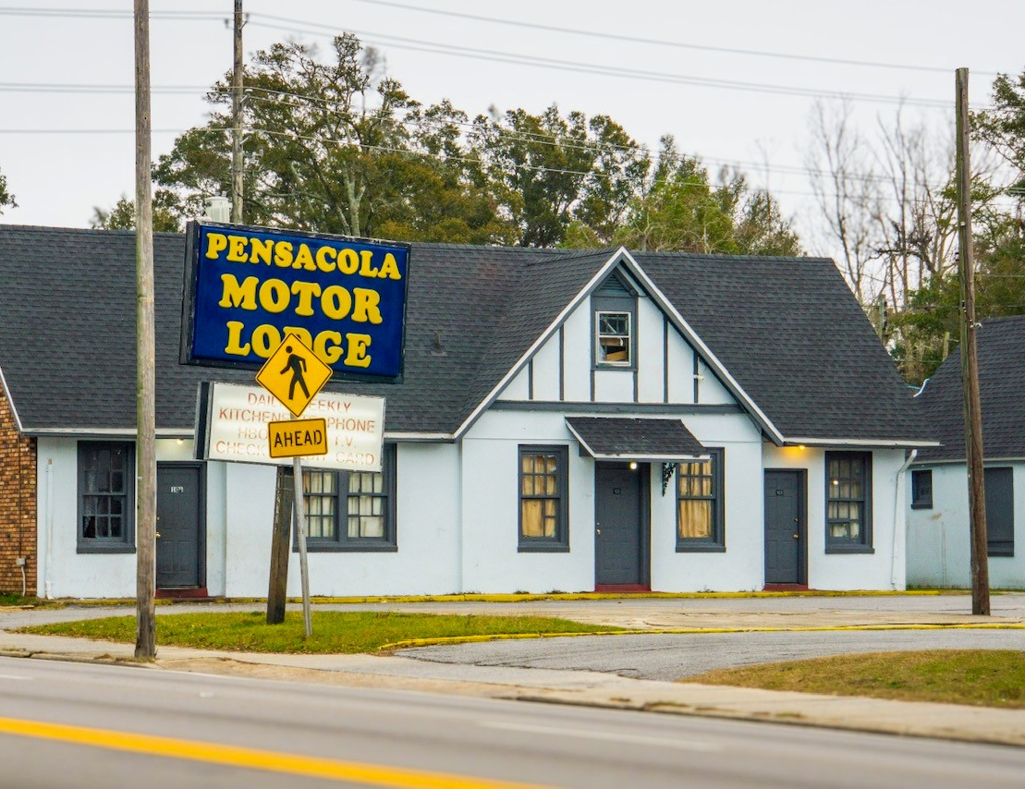
another
development opportunity
2305 W Cervantes Street – affordable housing
Acreage: 1.67 acres
Max Height: 10 stories (Bonus Available)
Density: 35 du/acre (Bonus & Transfers Available)
MARCH 11, 2024
We’re seeking:
INFORMATIONAL CONFERENCE & SITE VISIT
Affordable Multifamily Rental (Mixed Income: 50% at 60%AMI or less; Up to 100%. AMI) – Rehab, new construction or both.
MARCH 15, 2024
FREQUENTLY ASKED QUESTIONS
MARCH 24, 2024
CLOSE DATE (Subject to Extension)
5:00 p.m. local time
*EXTENSIONS WILL BE POSTED TO THE WEBSITE & NOTIFICATION SENT VIA THE “NOTIFY ME” LISTS
RESPONDENTS WILL BE NOTIFIED DIRECTLY OF NEXT STEPS

