Slide 1
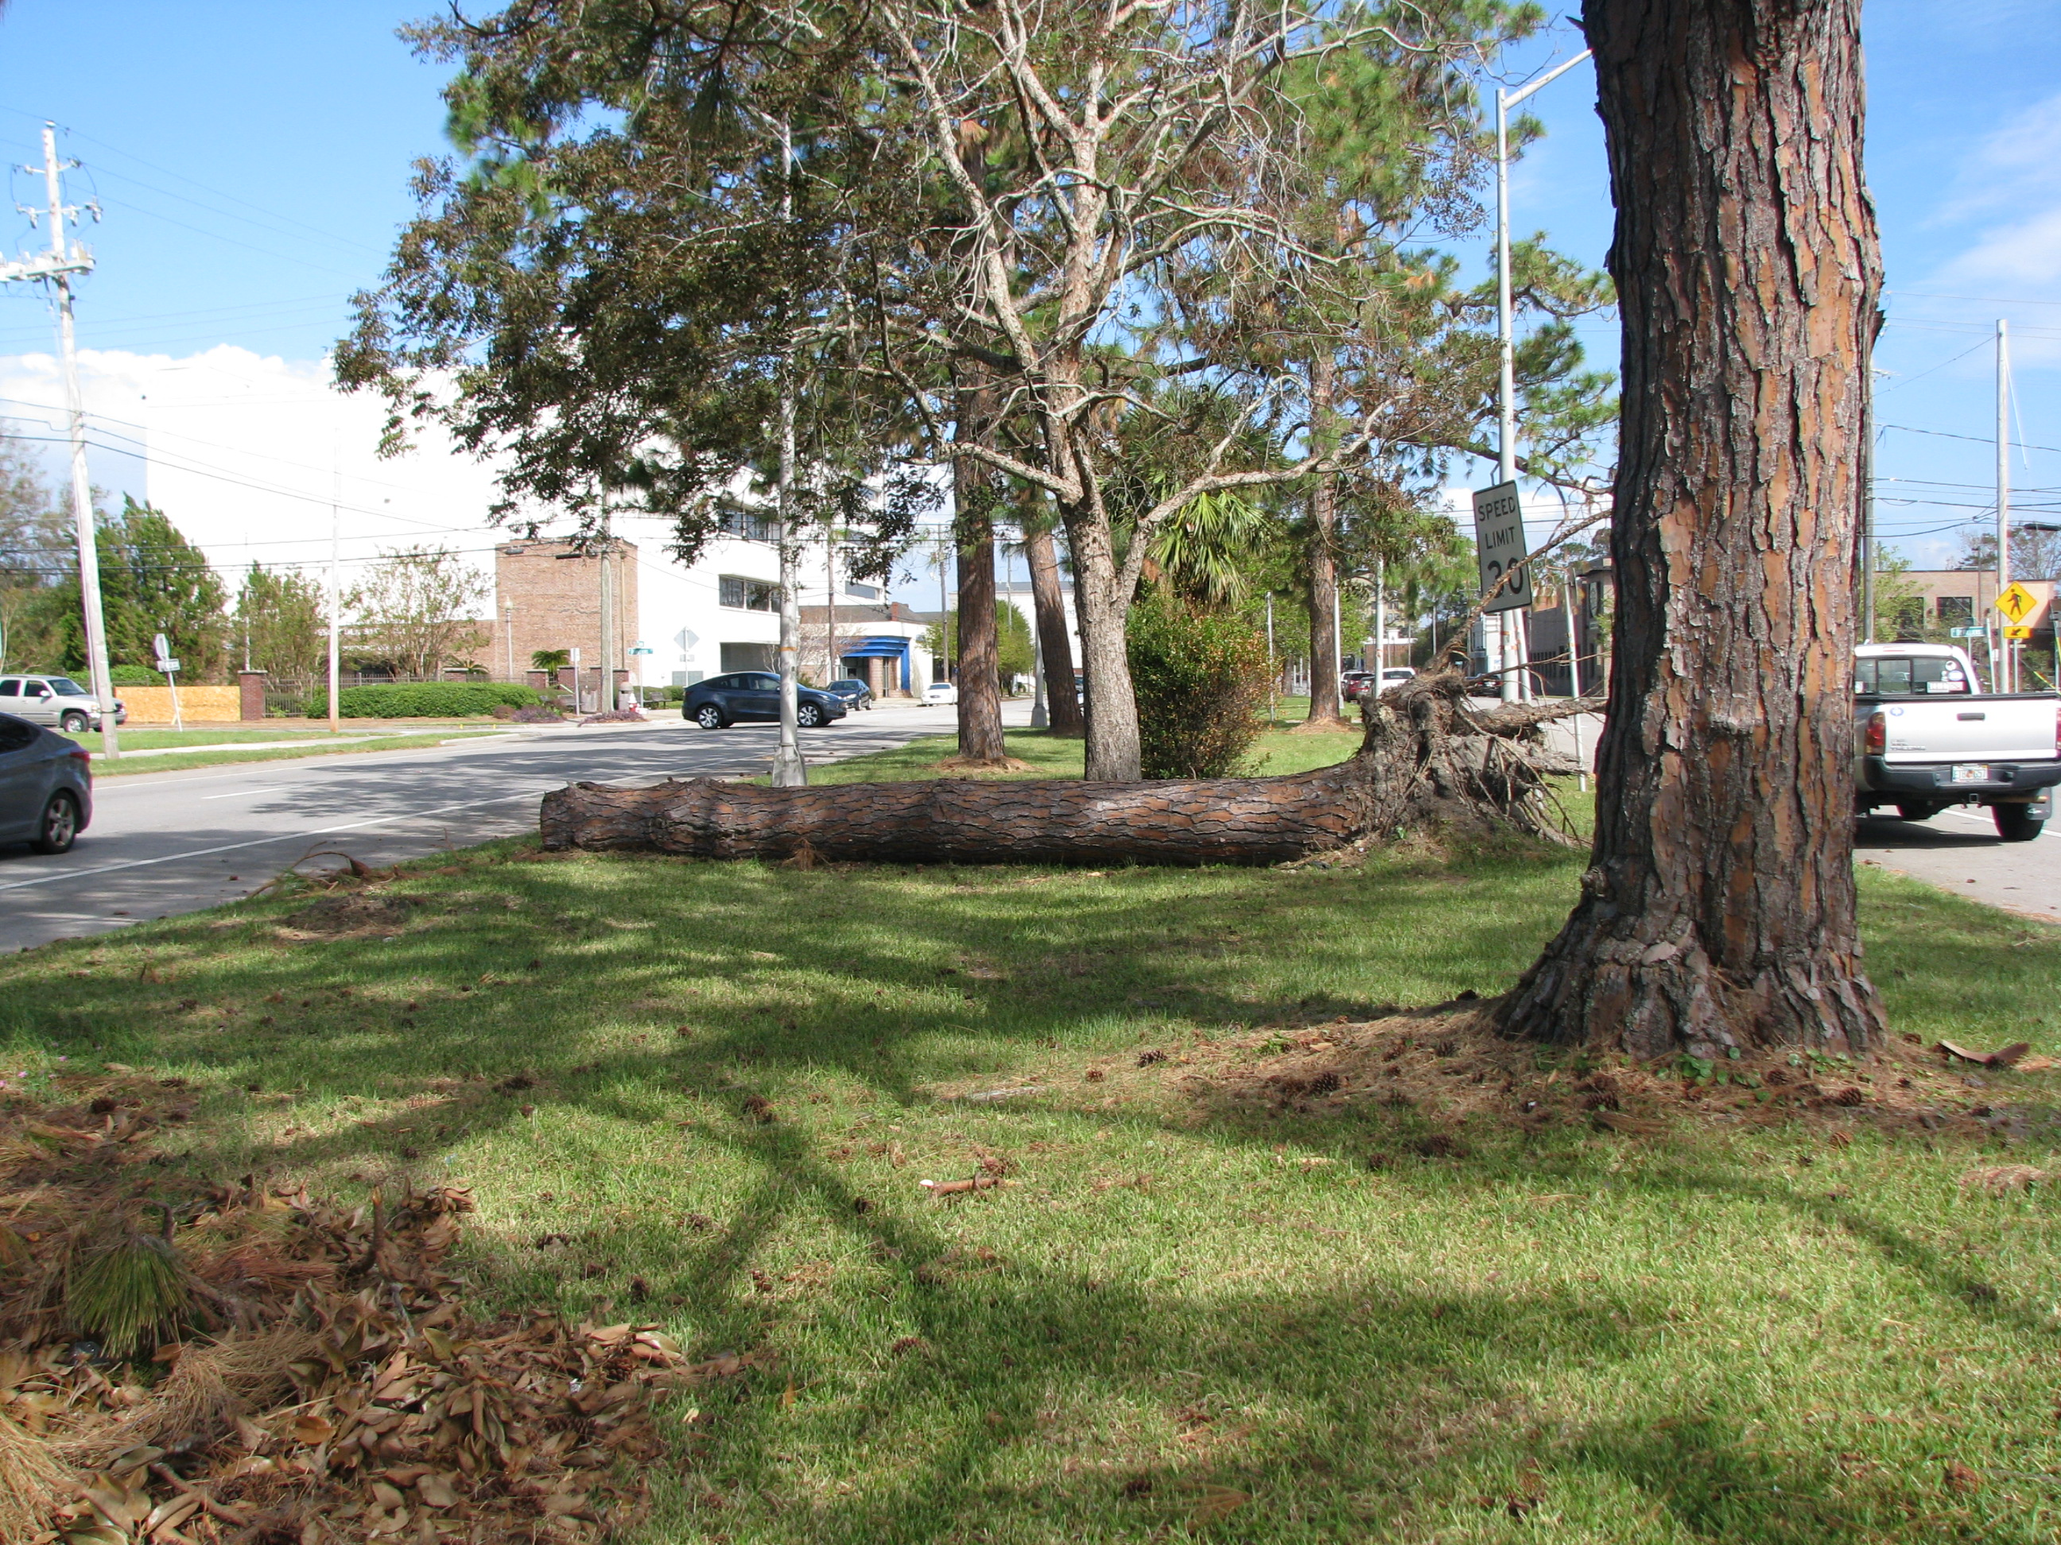
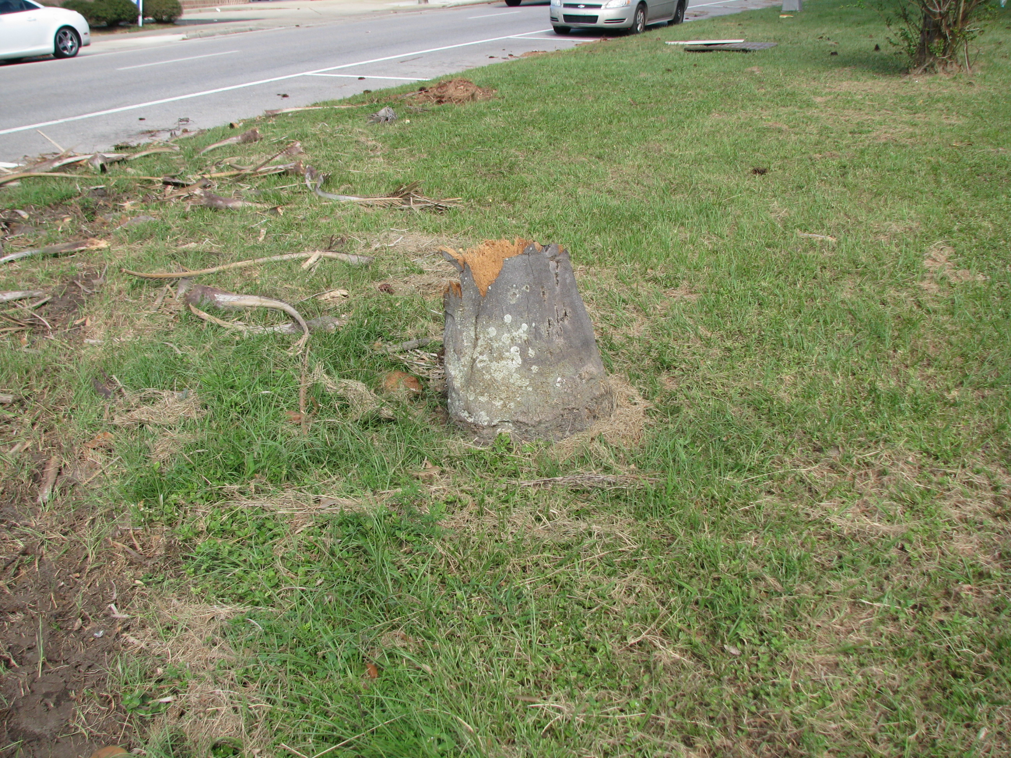
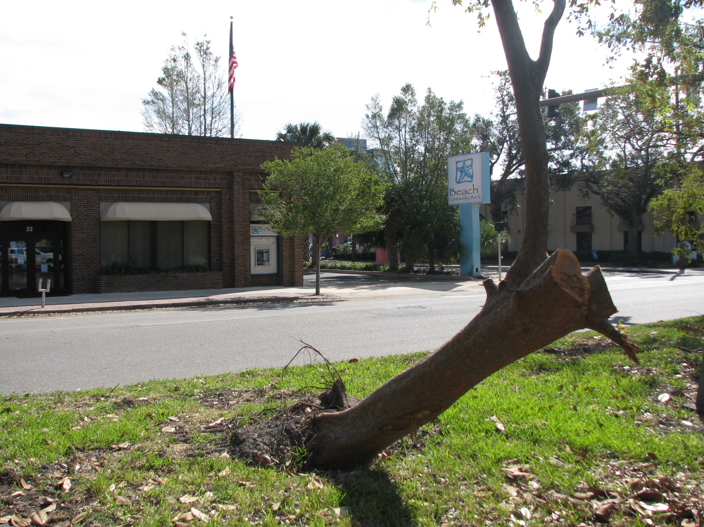
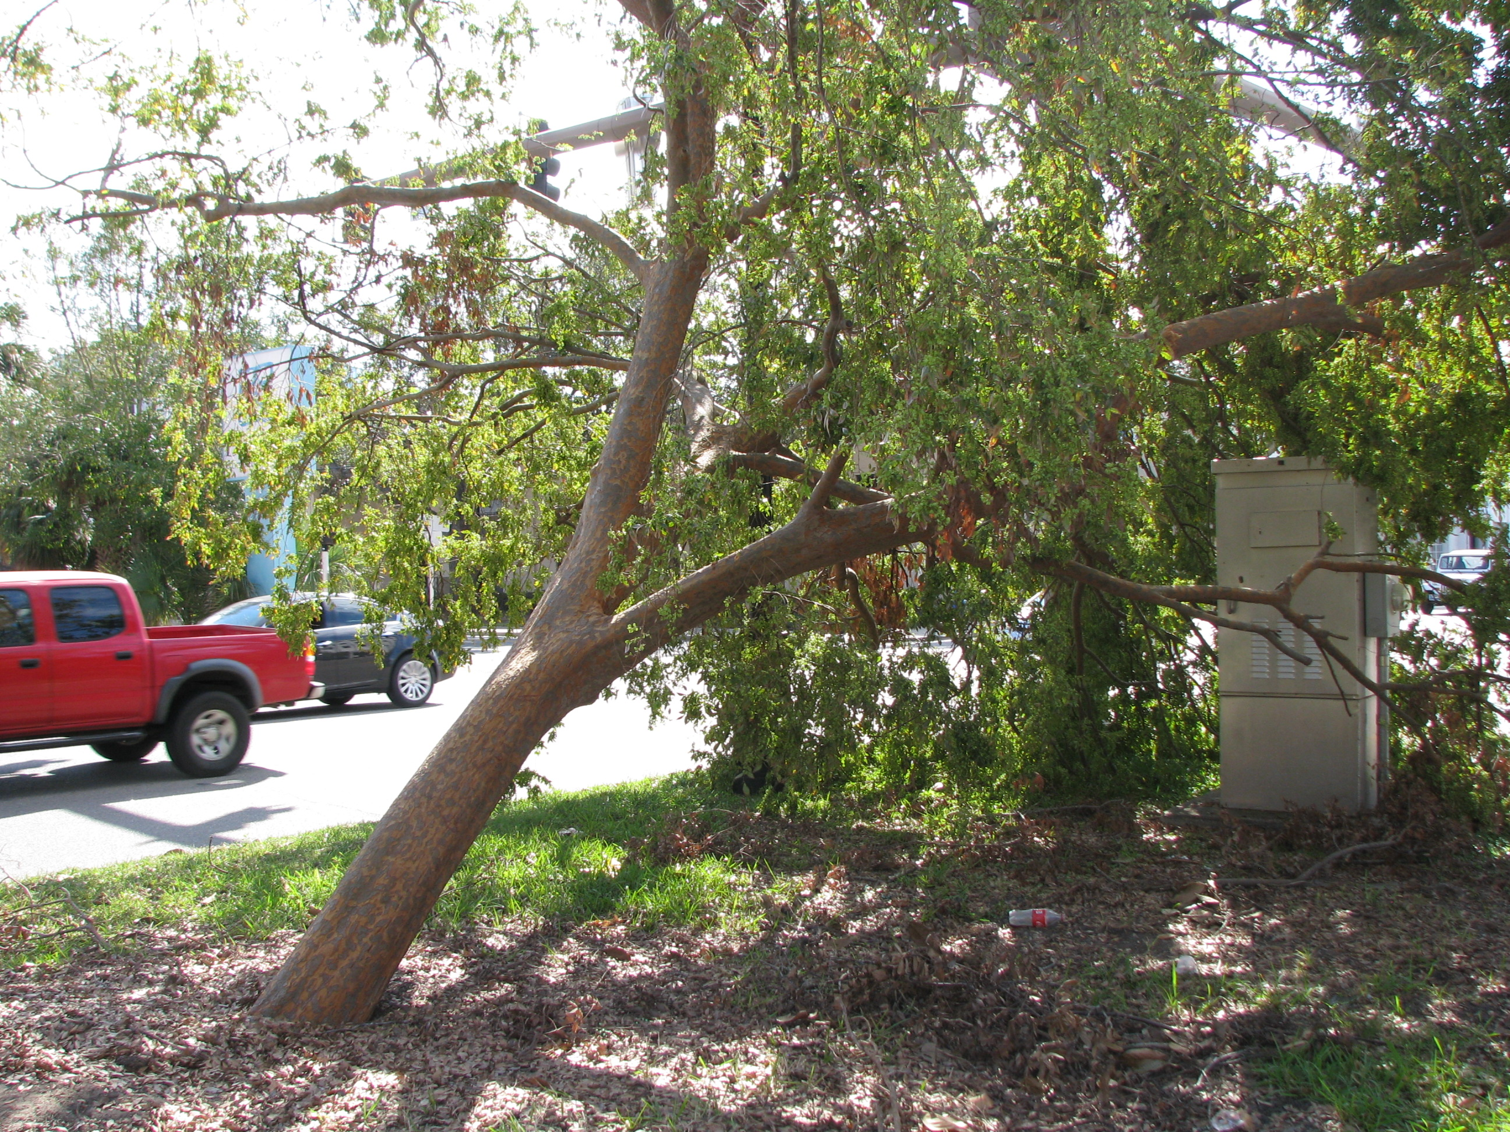
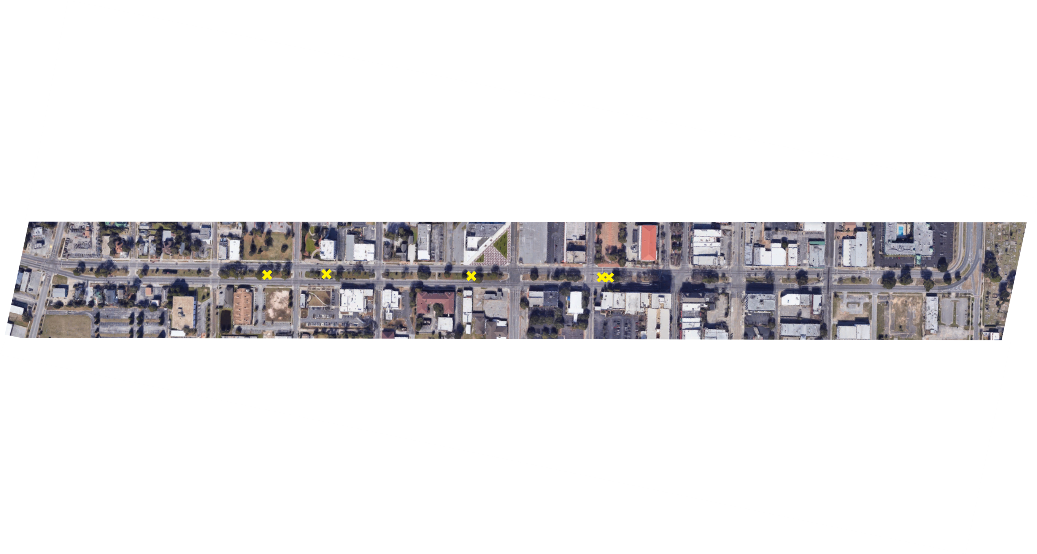
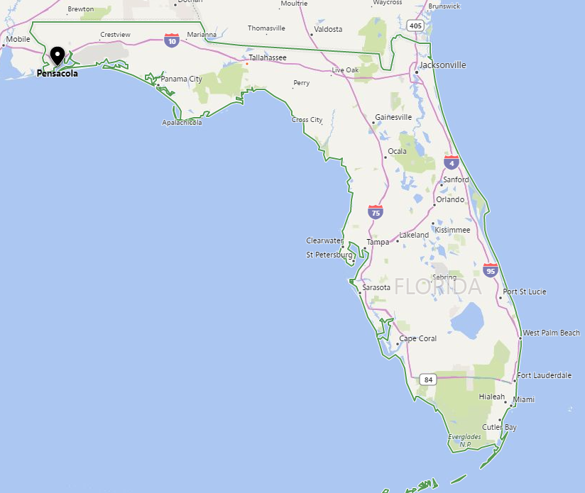
A Street to Donelson
At Blue Star Highway Memorial sign trim existing boxwoods and add colorful ground cover
Remove 4 Sabal Palms, 1 Yucca, and all azaleas
Add 2 Crape Myrtles
Spring to Baylen
Add trash receptacle at plaza with benches similar to those used in previous Pensacola projects
Add 1 Crape Myrtle
Tarragona to Alcaniz
Remove all shrubs
Remove 1 Crape Myrtle
Remove 1 Sabal Palm
Add 1 Crape Myrtle
Limb up Crape Myrtles in circular planter and paint base terra cotta
Reus to Spring
Remove 1 Crape Myrtle
Remove 3 Camellias
Limb up Camelia to remain
Remove damaged tree
Palafox to Jefferson
Remove Crape Myrtle
Remove 1 Pine
Add 1 Live Oak
Coyle to DeVilliers
Remove 3 sabal palms
Remove all shrubs
A Street
Donelson
Coyle
DeVilliers
Reus
Garden Street
Spring
Baylen
Palafox
Jefferson
SR 30-Bus. US 98
Tarragona
Alcaniz
Donelson to Coyle
Remove 3 damaged trees
Remove shrubs
Add border of liriope at base of fence around locomotive
DeVilliers to Reus
Remove Pindo Palm
Remove 2 Crape Myrtles
Project Limits: SR 30-Bus. US 98
A Street to Alcaniz Street
Baylen to Palafox
Remove 3 Sabal Palms
Jefferson to Tarragona
Remove 3 Sabal Palms
Remove 1 Crape Myrtle
Add 1 Live Oak
NORTH
0
200
400
General Notes
Evaluate and adjust existing irrigation, as needed, to provide full coverage
Remove all existing shrubs
Remove all palm trees
Evaluate existing grass to remain; use selective herbicide; and, sod remaining areas, as needed
Add large beds and bands of pine straw mulch in dense canopy areas where shade precludes grass lawns
Remove all vines and prune existing trees to remain under the direction of a certified arborist
Remove suckers from Crape Myrtles
Landscape Palette
For ease of maintenance, plants selected are consistent with similar plants along the eastern end of Garden Street and other locations in Pensacola:
Centipede Sod
Asian Jasmine
Liriope
Dwarf Yaupon Holly
Drift Roses
Dwarf Azaleas
Crape Myrtles
Live Oaks
Muhly Grass
Concept Design Narrative
Evaluation attributes indicated in the grant application are referenced by footnotes.*
The Garden Street (SR 30-Business US 98) median beautification concept extends from A Street at the West to Alcaniz Street at its eastern limit. The existing landscape includes mature oaks, crape myrtles, elms, magnolias, and pines that provide a great base of materials for a median landscape that can be augmented^{1,2} with the strategic placement of additional trees, shrubs, and groundcovers.⁷ Existing trees that are dead, dying, damaged, or are in locations no longer appropriate, shall be removed.⁷ All trees to remain shall be cleaned of vines, pruned and shaped under the direction of a certified arborist^{7,10}. New trees, shrubs, and groundcover materials shall be selected for low maintenance^{2,3,8} and to provide seasonal color and forms consistent for an urban median landscape¹. For open visibility in line with the principles of CPTED, as well as with FDOT limit of clear sight criteria⁴, the design intent is to maintain an open form with low growing groundcover and shrubs, and with tree canopies that are maintained for sight visibility⁷. Existing irrigation will be evaluated and upgraded to provide full coverage to the landscape materials with specific intent to eliminate potential overspray onto paved areas.^{2,3,8} To limit litter along the median⁵, a new trash receptacle will be installed near the existing benches between Spring and Reus Streets. Bedlines, planting areas, grassed lawn areas, and mulched spaces shall be designed to provide aesthetic forms that complement the existing tree groups.^{1,7} Within the project limits, there are no outdoor advertising sign impacts.⁴ Existing utilities within the medians will need to be located to assure conflicts do not occur with the new landscape and irrigation improvements.³ The concept has been developed to emphasize the aesthetic attributes of the urban street median, with cost effectiveness² and low maintenance^{3, 8} criteria being considered in the plant palette selected⁹. The final design shall meet applicable FDOT and local street design criteria.⁴ The City of Pensacola is committed to the success of this project and is providing in-kind contributions through their CRA.^{6,10}
Pensacola
Location Map
Garden Street Median Beautification, Pensacola, Florida
Bruce W. Brodsky, RLA
FL LA 1742
September 2018

